Slide 1
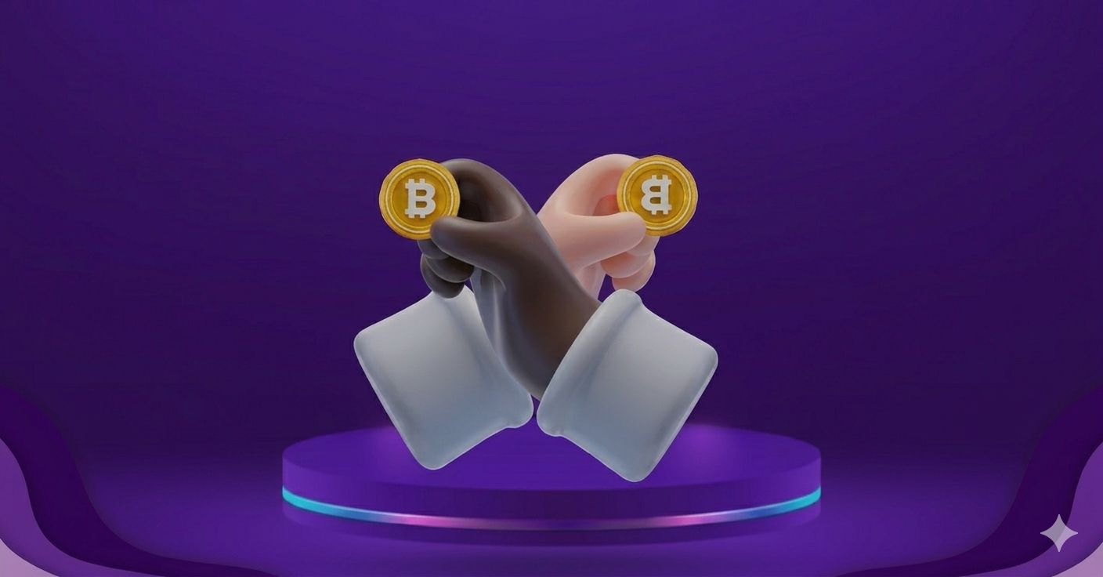
Finney attack in Bitcoin and Its Impact on Blockchain Security -------------------------

Slide 2









Introduction
Bitcoin is a digital currency based on blockchain that enables secure transactions without a central authority. However, it still has timing-related weaknesses. The Finney Attack is an example of a double spending risk caused by reliance on fast payments.

Slide 3
Understanding the Idea Behind the Attack
To understand the Finney Attack, it is important to know that Bitcoin transactions are not confirmed instantly but pass through a temporary unconfirmed state. During this time, the attacker (miner) exploits the timing delay to create two conflicting transactions using the same coins, leading to double spending.

Slide 4
How the Attack Happens (Simple Scenario)
In a Finney Attack, a miner exploits confirmation delay to perform double spending:
• creates a private block sending coins to themselves.
• pays a merchant with the same coins • merchant accepts without confirmation.
• publishes the hidden block.
Result: the merchant’s transaction becomes invalid. This is an exploitation of timing and trust, not a direct hack.

Slide 5
Technical Explanation
The Finney Attack requires the attacker to be a miner and perform pre-mining before making a payment.
• Hash power: enough computing power to mine a block
• Block propagation: the block spreads across the network after release
• Confirmation depth: more confirmations make reversal harder
Due to these requirements, the attack is relatively uncommon.

Slide 6
Comparison with Other Attacks
The Finney Attack can be compared with other double spending attacks:
• Race Attack: no mining required, two transactions sent simultaneously
• Finney Attack: requires mining and precise timing
• 51% Attack: requires majority hash power
This shows that the Finney Attack has moderate difficulty compared to others.

Slide 7
Why This Attack Matters ?
The Finney Attack is rare but important because:
• Transactions are not secure until confirmed
• Fast payments can be risky
• User behavior affects security
Overall, the risk is both technical and human-related.

Slide 8
Security Insight
The Finney Attack shows that security is not only about the system, but also user behavior.
• Technical system (Blockchain)
• User decisions (waiting or not)
Overall, security depends on the interaction between humans and the system.

Slide 9
Prevention and Mitigation
To reduce the risk of the Finney Attack:
• Wait for transaction confirmations
• Avoid zero-confirmation payments
• Use solutions like the Lightning Network
• Monitor network activity
Overall, protection depends on both technology and user awareness.

Slide 10
Simulation
A simple Python simulation demonstrates the Finney Attack using a basic blockchain model, showing how hidden blocks enable double spending and how merchants can lose payments when accepting unconfirmed transactions, making the concept easier to understand.

Slide 11

Conclusion
The Finney Attack shows that blockchain security depends on both technology and user behavior. While Bitcoin is secure after confirmations, delays can be exploited if users trust instant payments. Overall, security depends on how users interact with the system.

